Slide 1
Visual-to-audio aid for visually impaired
Team: Sidharth Pal Siddharth Anil Naik
Image Sources : allppt.com, unspalsh.com

Slide 2
Agenda
01
Visual Impairment
02
Existing technological aids
03
Computer vision and AI
04
Project idea
Image Sources : allppt.com, unspalsh.com

Slide 3
Visual Impairment
Visual impairment, also known as vision impairment or vision loss, is a decreased ability to see to a degree that causes problems and is not fixable by usual means, such as glasses.
Data(as of 2015): - 940 million people had some degree of vision loss - 246 million people had low vision - 39 million people were blind
O
OPPORTUNITIES
THREATS
Image Sources : allppt.com, unspalsh.com

Slide 4
Distribution of visually impaired people
By gender
By age
<
Females have a significantly higher risk of being visually impaired than males
More than 82% - 50 years of age and older
By geography
More than 90% of the world's visually impaired live in developing countries.
Image Sources : allppt.com, unspalsh.com

Slide 5
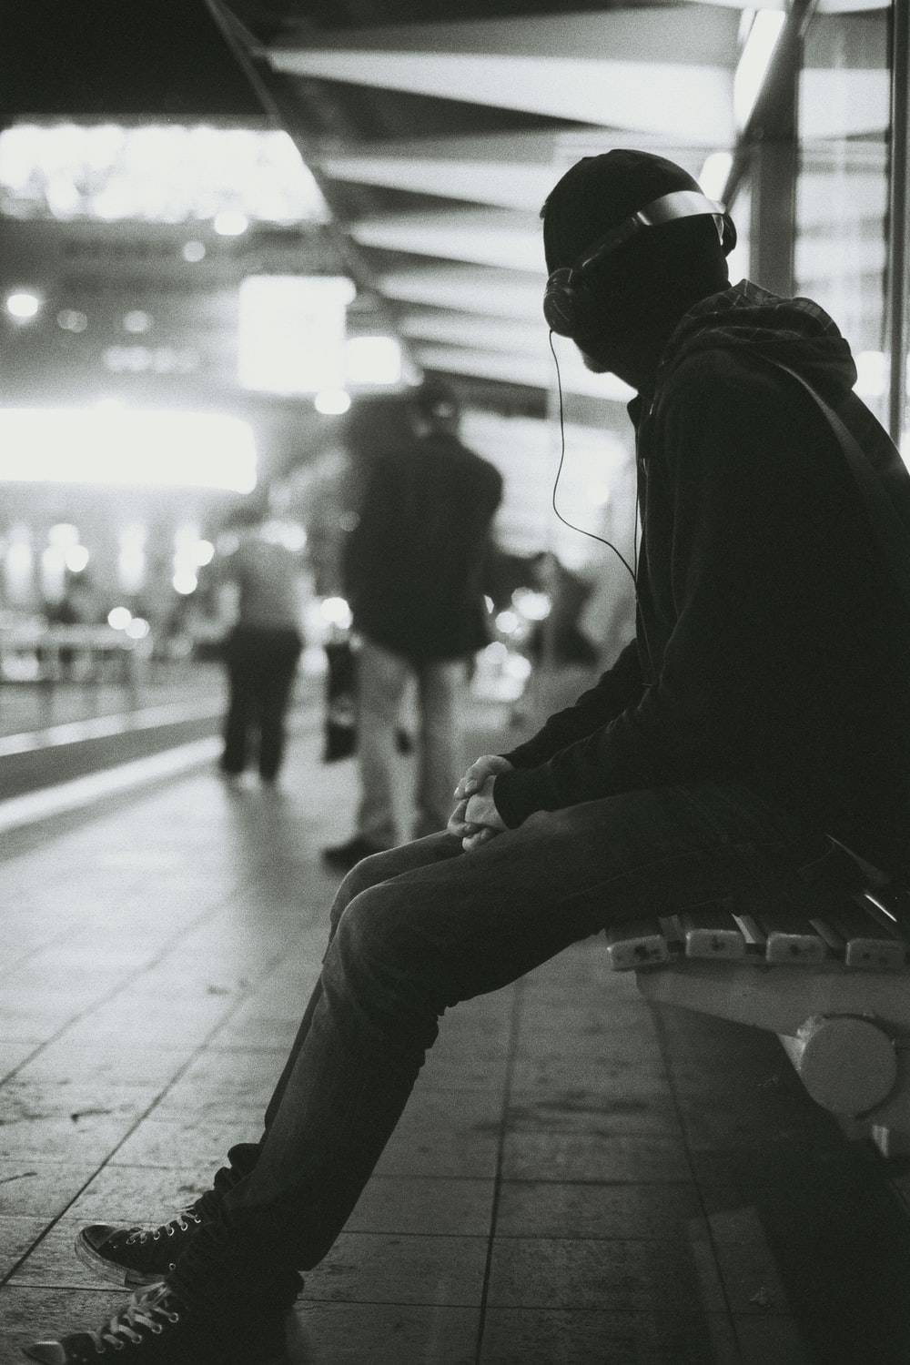





How technology aids at present
Screen readers
Audio traffic signals
Refreshable Braille displays
GPS
Radio reading devices
Image Sources : allppt.com, unspalsh.com

Slide 6



Computer vision
Computer vision is an interdisciplinary scientific field that deals with how computers can gain high-level understanding from digital images or videos
Image captioning is the process of generating meaningful caption upon understanding the given image using computer vision
Image Sources : allppt.com, unspalsh.com

Slide 7
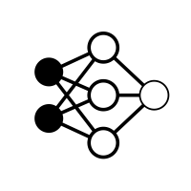
Deep Neural networks to be used
01
Convolutional neural network
02
Recurrent neural network
03
Long short-term memory
Image Sources : allppt.com, unspalsh.com

Slide 8



How AI can help - image captioning
The video stream captured in front of the person can be sampled at intervals
The image frames can be processed for feature matrix
The image frames and CNN output can be fed to an LSTM based RNN to generate meaningful caption
Image Sources : allppt.com, unspalsh.com

Slide 9


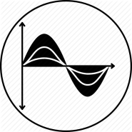

How AI can help - Semantic text similarity
The new caption along with older caption are checked for semantic text similarity
Both captions are converted to vectors using word to vector or similar embeddings
The cosine difference between the vectors are calculated
In case of significant difference the new caption is converted to speech
Image Sources : allppt.com, unspalsh.com

Slide 10
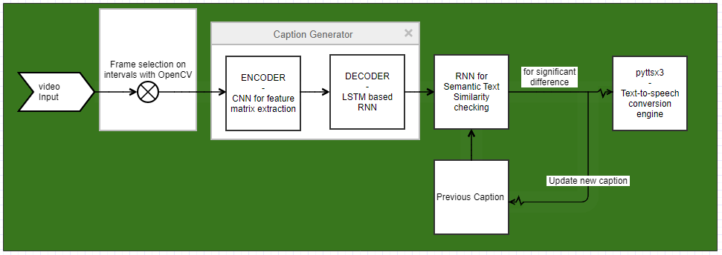
Architecture Diagram

Slide 11

Datasets
COCO dataset (benchmark):
5 captions per image
>330k images
STSbenchmark dataset:
8628 sentence pairs

Slide 12






Sources and Links
https://en.m.wikipedia.org/wiki/Computer_vision https://cs224d.stanford.edu/reports/mcelamri.pdf&ved=2ahUKEwj7lMWRlp7pAhUQXpoKHUmECZUQFjACegQIDBAH&usg=AOvVaw2dVGHsBcGfLG-SOkqViWmC https://medium.com/@adriensieg/text-similarities-da019229c894 https://docs.opencv.org/3.4/dd/d43/tutorial_py_video_display.html https://www.tensorflow.org/tutorials/text/image_captioning https://pypi.org/project/semantic-text-similarity/ https://github.com/tensorflow/hub/blob/master/examples/colab/semantic_similarity_with_tf_hub_universal_encoder.ipynb https://pypi.org/project/pyttsx3/

Slide 13
Thank You
Image Sources : allppt.com, unspalsh.com

